Slide 1
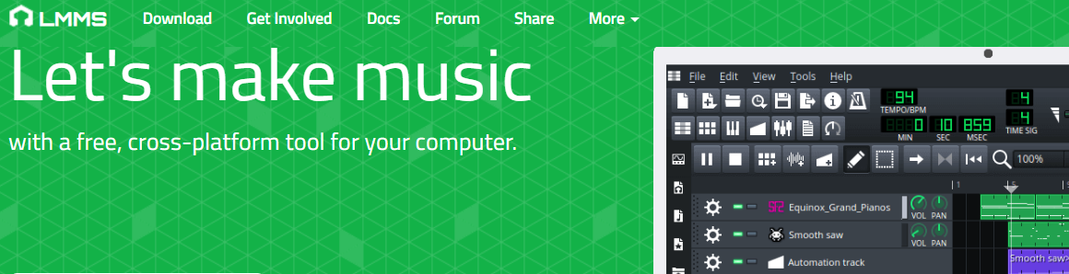
Endless Idea’s
Music Production - LMMS
LMMS is a simple yet powerful digital audio workstation (DAW). It is a basic foundation for music composition and sound production, LMMS is a way to create your own sound.

Slide 2
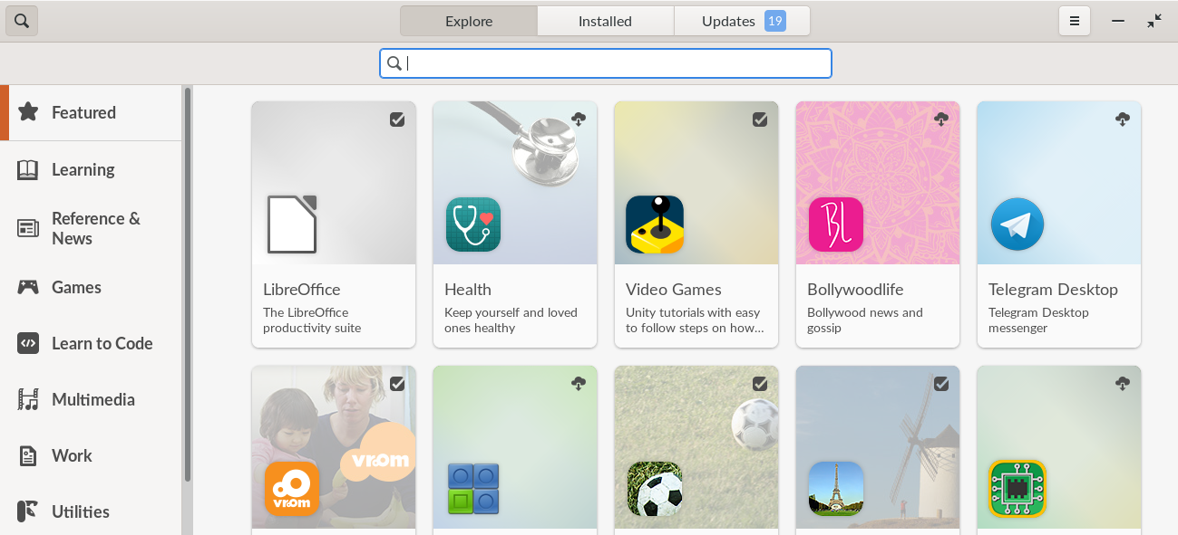
Enter LMMS into the Search Bar
Find and hit the return key when you find LMMS

Slide 3
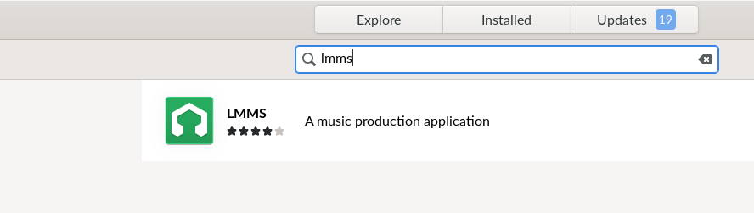
Click on the LMMS Icon and install.

Slide 4
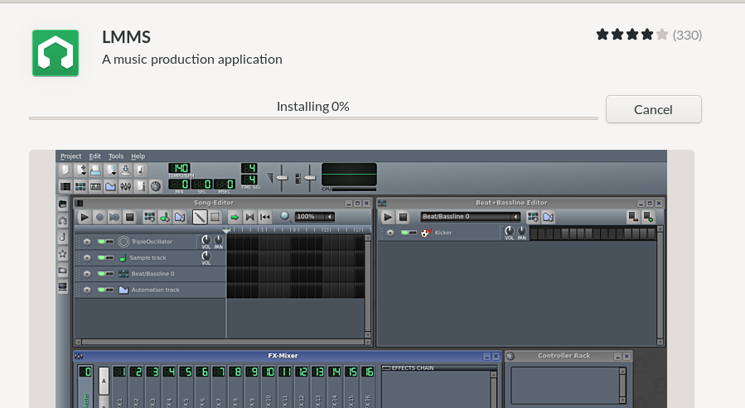
Click on the LMMS Icon to start the download

Slide 5
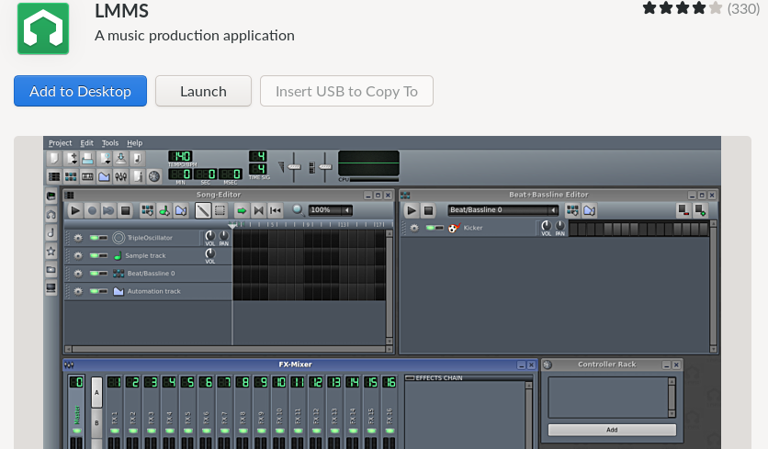
Download Complete – You can Launch

Slide 6
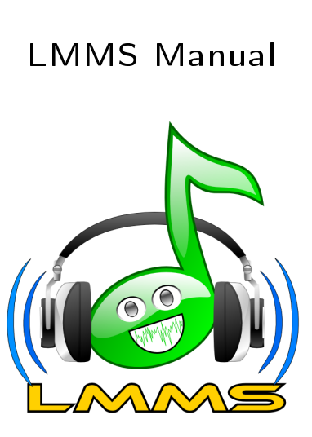
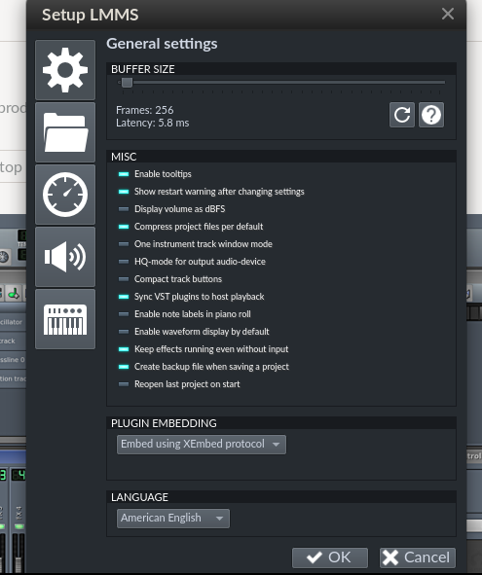
Here is where to download the manual.
https://www-user.tu-chemnitz.de/~doto/lmms/manual.pdf
You can print the manual or place it into shared documents.

Slide 7
Music Production
Several youth made recommendations for music production software – something similar to Garage Band.
LMMS is an open software that runs on Linux, Apple and Windows platforms. Students can continue their compositions after they leave.
Note: At times youth may choose to use abusive language in recordings. How staff and educators relate to youth on these issues are of merit to consider ahead of time. Youth content may tread on treatment issues, abuse history, trauma and neglect.

