Slide 1


Endless Idea’s
Dictionary – WORDS
WORDS is a simple, yet powerful, dictionary. Doesn’t require internet access. It can read the words and their definitions with its robotic voice. Works in many different languages.

Slide 2
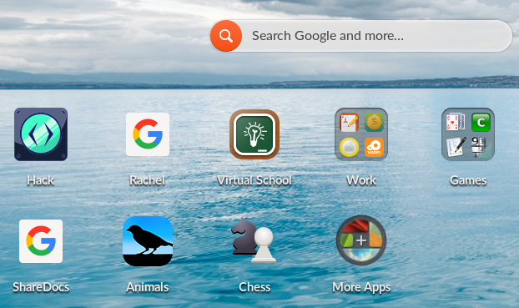
Start by clicking on the App Center
Time to get an offline dictionary
Click on the “More Apps” icon.

Slide 3
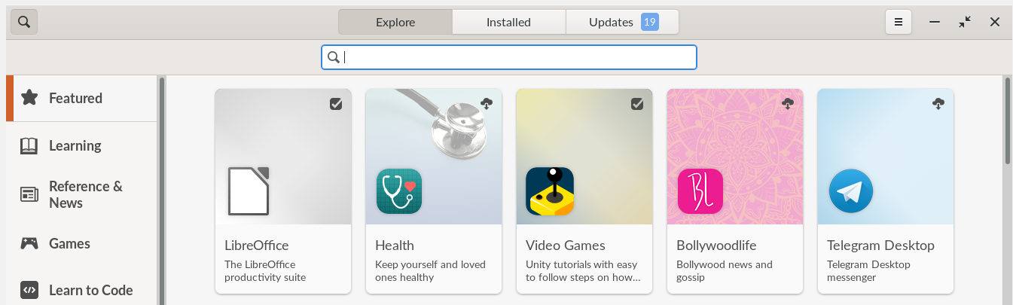
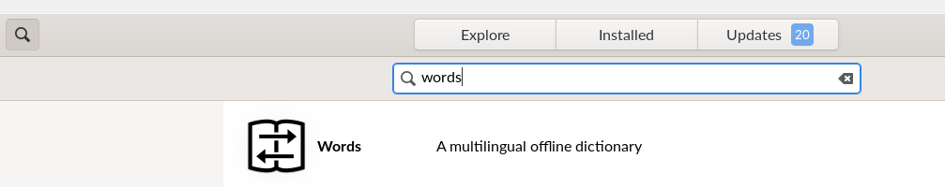
Type “Words” in the search bar and then the Return key.

Slide 4
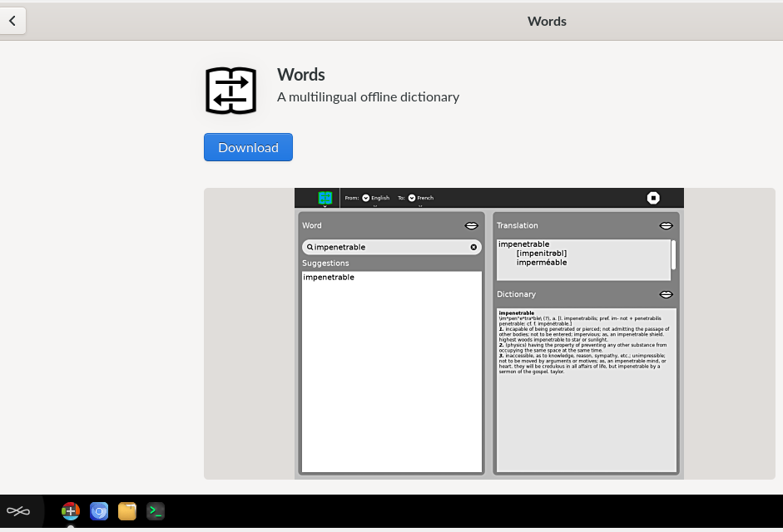
Time to down load - Words
Click on download
You can see the download in progress

Slide 5
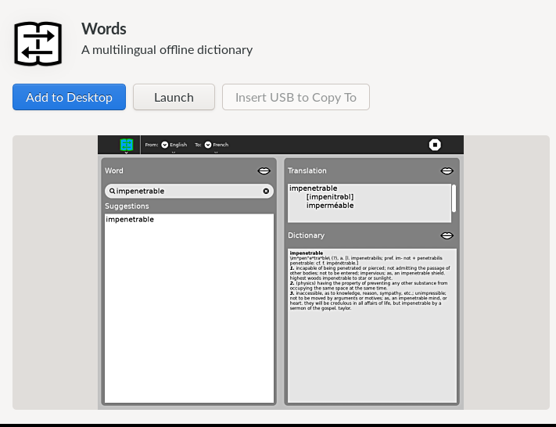
Ready to go
When the down load and install is finished:
  You can add Words to your Desk Top and/or Launch the application

Slide 6
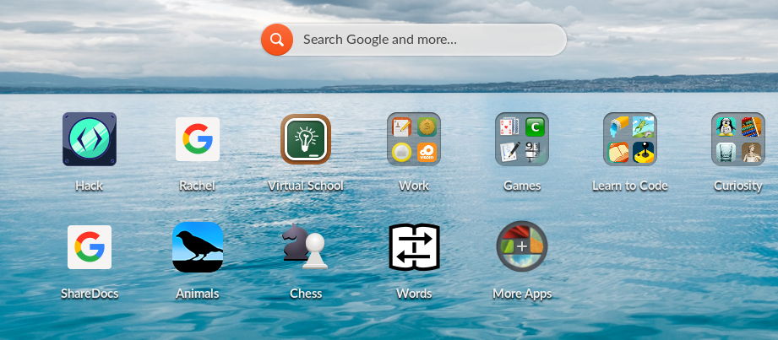
Words on your desktop
Easy access to look for definitions and translation.

Slide 7
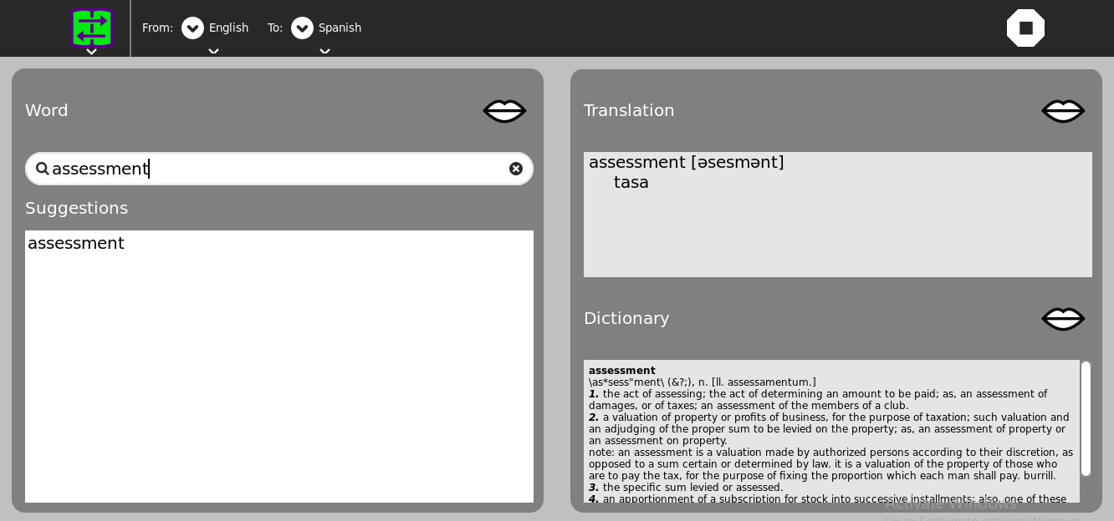
Launch and look up a word definition.
Close App
Audio playback
You can also see the word translated into Spanish.

Slide 8
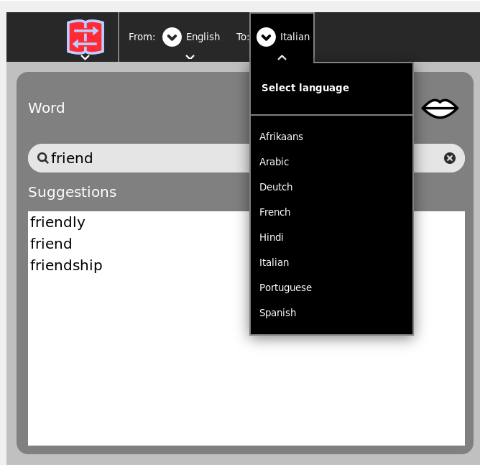
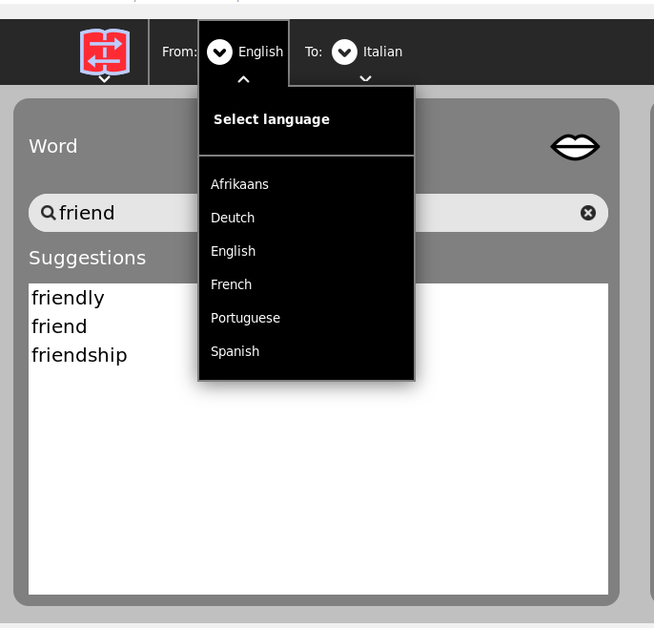
You can translate words in several languages

Slide 9
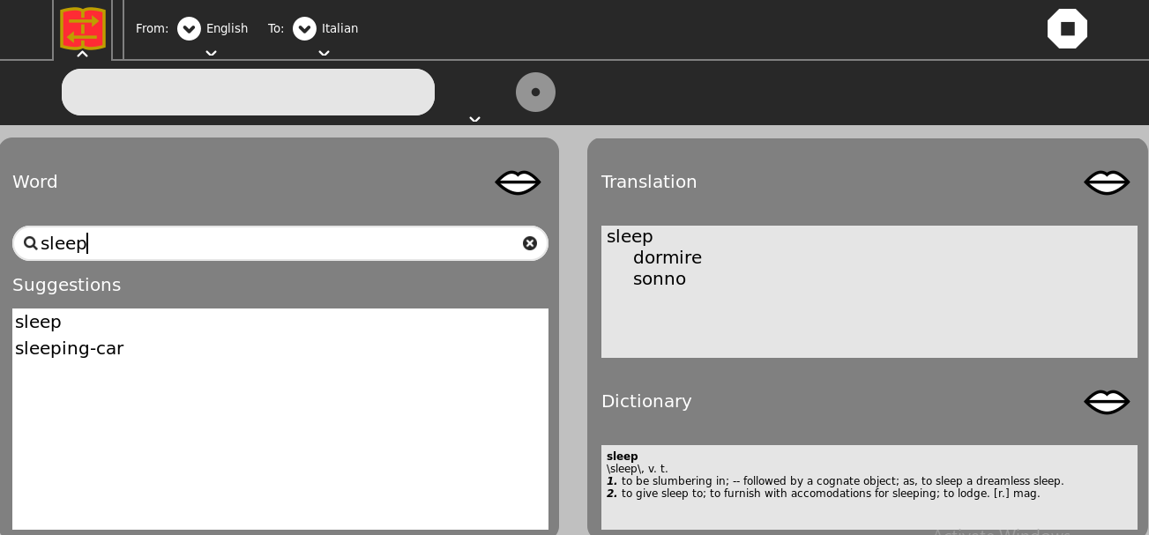
Enjoy using Words.
Click here to close application.

